Slide 1

Custom Scripting
Roger C. Dugan
Sr. Technical Executive, EPRI
Jacobs Hall, UCSD
Dec 14-15, 2010

Slide 2
Custom Simulation Scripting
We’ll Discuss Custom Scripting in 2 modes:
  In Snapshot mode
  In “Time” mode

Slide 3
Custom Simulation Scripting in
Snapshot Mode
This is the default solution mode
Attempts one solution for each “solve”
Solves the circuit “as is”
If you want something done, you have to specifically tell it
  Set Load and Generator kW, etc.
    Load.MyLoad.kW=125
    Loadshapes are not used in this mode!
  Sample Monitors and meters
    Solve
    Sample

Slide 4
Custom Simulation Scripting in
Time Mode
Similar to Snapshot mode EXCEPT:
  Loads, Generators can follow a selected Loadshape
    Duty, Daily, or Yearly
  Monitors are automatically sampled
    But not Energymeters; do that explicitly if desired
  Time is automatically incremented AFTER solve

Slide 5
Snapshot Mode Scripting Example
Set Gen kW explicitly each time step
! Start the ramp down at 1 sec
Set sec=1
Generator.PV1.kW=(2500 250 -)
Solve
Sample
Set sec=2
Generator.PV1.kW=(2500 500 -)
Solve
Sample
Set sec = 2.020834372 ! Unit 1
storage.jo0235001304.state=discharging %discharge=11.9
Solve
Sample
Set sec = 2.022028115 ! Unit 2
storage.jo0235000257.state=discharging %discharge=11.9
Solve
Sample
Set sec = 2.023158858 ! Unit 3
storage.jo0235000265.state=discharging %discharge=11.9
Solve
Sample
Set sec = 2.024604602 ! Unit 4
storage.jo0235000268_1.state=discharging %discharge=11.9
Solve
Sample
Set sec = 2.025738325 ! Unit 5
storage.jo0235000268_2.dispmode=discharging %discharge=11.9
Solve
Sample
Etc.
Solve and Sample explicitly at each step
Set each Storage unit discharge rate explicitly each time step
(time is used for recording purposes only)

Slide 6
Time Mode Scripting Example
All Loads, Generators will follow assigned Duty cycle loadshape
! Start the ramp down at 1 sec
Set mode=time loadshapeclass=duty
set stepsize=1s
Solve ! Base case t=0
Solve ! t=t+1 = 2
Solve ! t=2 second solution; t=t+1 = 3
Set sec = 2.020834372 ! Unit 1 (reset t)
storage.jo0235001304.state=discharging %discharge=11.9
Solve
Set sec = 2.022028115 ! Unit 2
storage.jo0235000257.state=discharging %discharge=11.9
Solve
Set sec = 2.023158858 ! Unit 3
storage.jo0235000265.state=discharging %discharge=11.9
Solve
Set sec = 2.024604602 ! Unit 4
storage.jo0235000268_1.state=discharging %discharge=11.9
Solve
Set sec = 2.025738325 ! Unit 5
storage.jo0235000268_2.dispmode=discharging %discharge=11.9
Solve
Etc.
Set sec=3
Solve ! t=3 solution; t=t+1 = 4
….

Slide 7
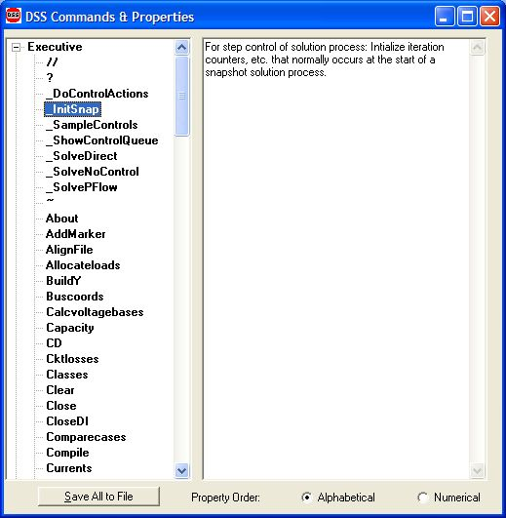
Custom Simulation Scripting:
Rolling Your Own Solution Algorithm
These commands allow step-by-step control of the solution process

Slide 8
Custom Simulation Scripting: Rolling Your Own Solution Algorithm
The basic Snapshot solution process:
  Initialize Snapshot (_InitSnap)
  Repeat until converged:
    Solve Circuit (_SolveNoControl)
    Sample control devices (_SampleControls)
    Do control actions, if any (_DoControlActions)
You may wish, for example, to interject custom control actions after the _SolveNoControl step

Slide 9
Custom Simulation Scripting, cont’d
Via COM interface
  Whatever you want (if you can write code)
See Examples Folder on Sourceforge site
  Excel: SampleDSSDriver.xls
  Matlab:
    VoltageProfileExample.m
    DSSMonteCarlo.m

Slide 10
For More Information …
See OpenDSS Custom Scripting.Doc
  (Sourceforge site, “Doc” Folder)

Slide 11
Example:
Energy Storage Dispatch

Slide 12
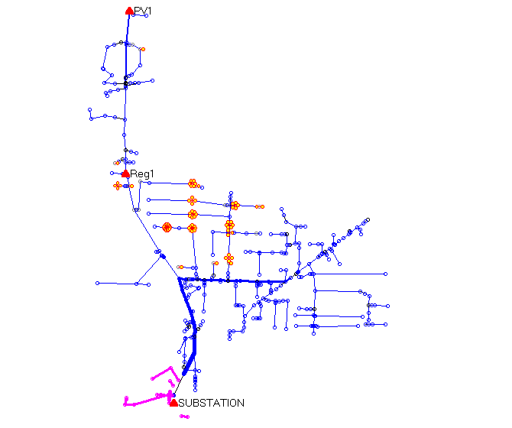
The Problem (A Hypothetical Case)
PV Location (2.5 MW)
Voltage regulator
Clusters of
Storage Units
Ref: EPRI/AEP Smart Grid Demo
Community Energy Storage Concept

Slide 13
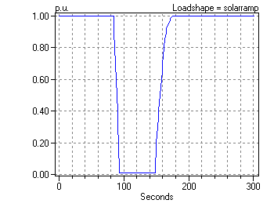
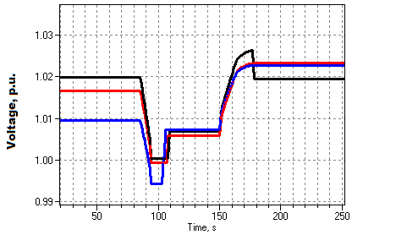
Solar Ramp Rate Issue
Assumed Solar Ramping Function
Result

Slide 14
The Question
Can you dispatch the 84 CES units fast enough to compensate for the sudden loss of PV generation on a “Cloud Transient” ?
Why it might not work:
  Communications latency
  CES not in right location or insufficient capacity
Calls for a “Hybrid” simulation
  Communications network (NS2)
  Distribution network (OpenDSS)

Slide 15
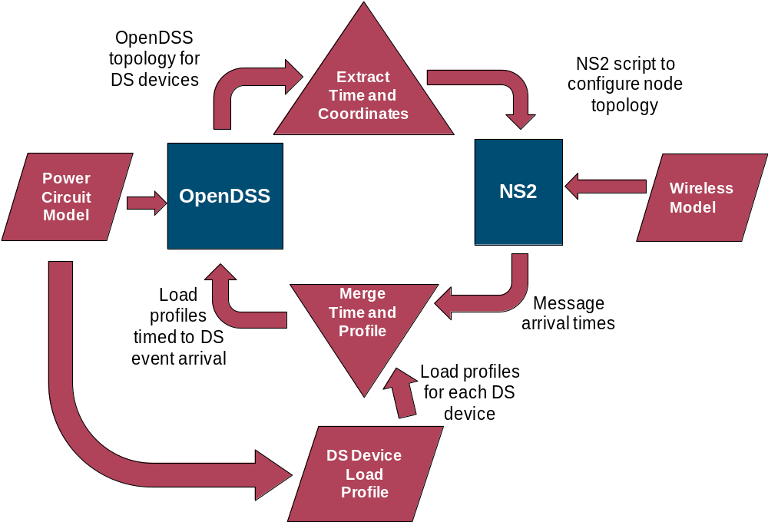
How We Did It

Slide 16
OpenDSS Script (Snippet)
Set sec=20
Solve ! Init steady state at t=20
Sample
! Start the ramp down at 1 sec
Set sec=21
Generator.PV1.kW=(2500 250 -) ! Decrement 10%
Solve
Sample
Set sec=22
Generator.PV1.kW=(2500 500 -) ! Decrement another 10%
Solve
Sample
Set sec = 22.020834372 ! Unit 1 message arrives
storage.jo0235001304.state=discharging %discharge=11.9
Solve
Sample
Set sec = 22.022028115 ! Unit 2 message arrives
storage.jo0235000257.state=discharging %discharge=11.9
Solve
Sample
Etc.

Slide 17
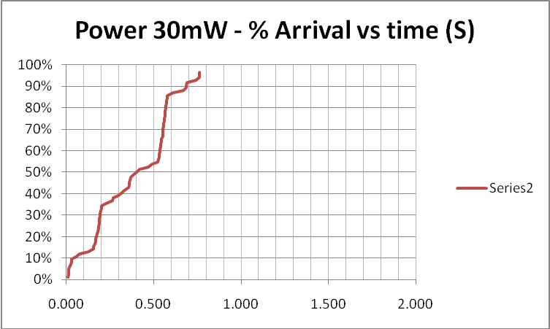
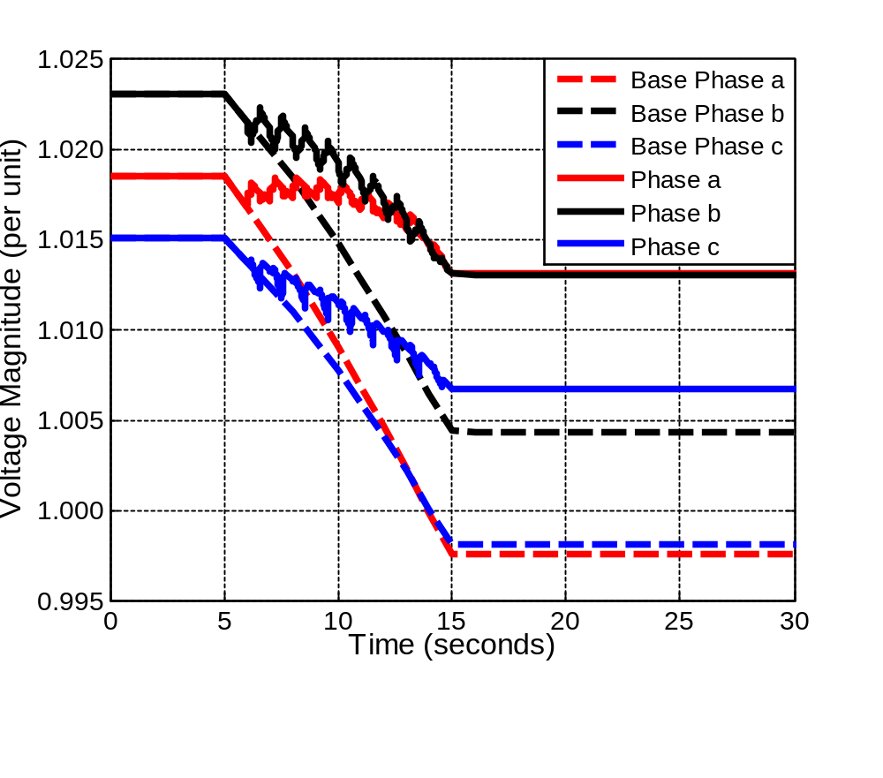
Results (for down ramp only)
Comm Simulation

Slide 18
Comm and Power Co-simulation
New and active reseach area
Working to more tightly link NS2 and OpenDSS
Communications latency is an important issue with Smart Grid
  Power engineers tend to assume communications will happen
  But there are limits

Slide 19
Together…Shaping the Future of Electricity

